Slide 1
FORD FUTURE STRATEGY

Slide 2
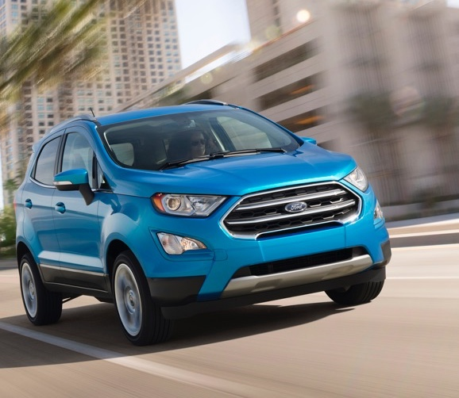
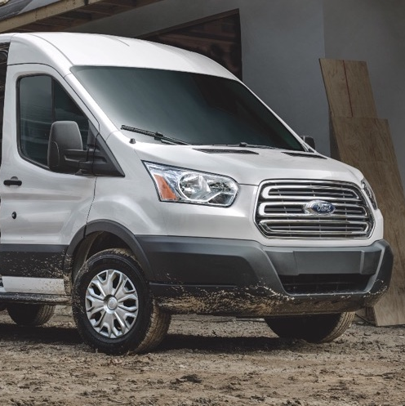
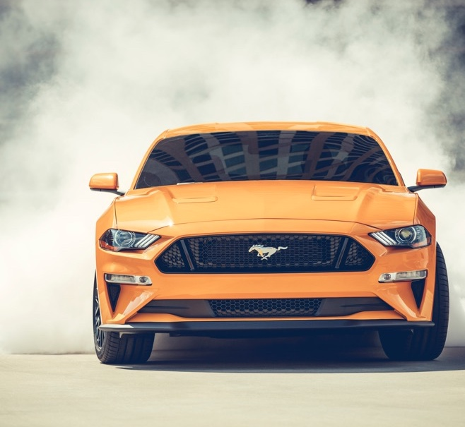



SHIFTING PORTFOLIO
ALIGNING WITH MARKET DEMAND
2015 NORTH AMERICA PLAN
(2016 – 2020)
2018 NORTH AMERICA PLAN
(2019 – 2023)
Utilities Trucks and Commercial Vehicles Cars
Notes:
We are reinvigorating our product lineup in the next 24 months… we will introduce more SUVs, Pickups, CVs and performance and off-road vehicles building on our strengths. We will have more models for our customers to choose from… not fewer… even as we phase out some sedans.
And, we’re playing to win in the places Ford has well-established strengths and advantages.
To make this happen, we’re allocating our capital differently.
90% of our capital is now allocated to trucks, vans and utilities, which make up more than half of our industry.

Slide 3



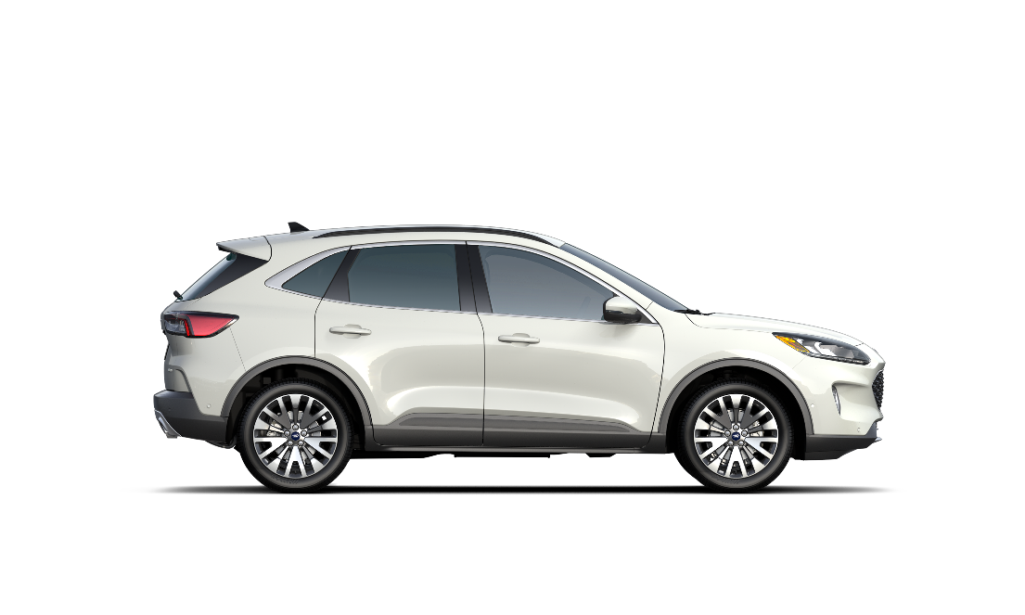

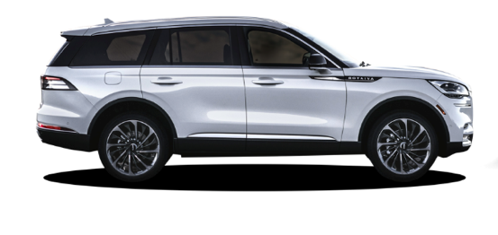
OVER NEXT TWO YEARS
U.S. UTILITY PORTFOLIO FRESHENS SIGNIFICANTLY
EXPLORER
7 NEW ENTRIES / MAJOR REFRESHES
BRONCO
SMALL RUGGED UTILITY
MUSTANG INSPIRED BEV
ESCAPE
LINCOLN AVIATOR
LINCOLN UTILITY
Notes:
We’re fortifying our lineup with more power, more capability, and more efficiency without compromise … as we continue with the transformation of our product portfolio.
Offering Seven new Utilities and major refreshed products by 2020.

Slide 4

OUR STRATEGIC APPROACH FOCUSES ON BUILDING A FOUNDATION FOR LONG TERM SUCCESS
PLAY TO OUR STRENGTHS
Commercial, trucks, utilities, performance
Building on our iconic nameplates; zero compromise battery electric vehicles
BUILD BRAND AND CREDIBILITY
LEVERAGE SCALE AND TECHNOLOGY
Design, volume, manufacturing and purchasing power
Ecosystem approach (charging, insurance and customer experiences)
BUSINESS MODEL INNOVATION

Slide 5
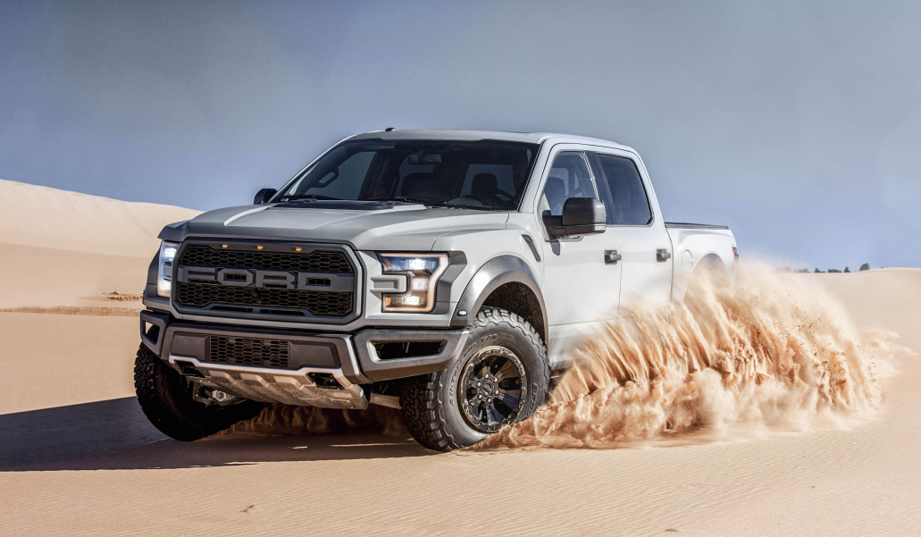

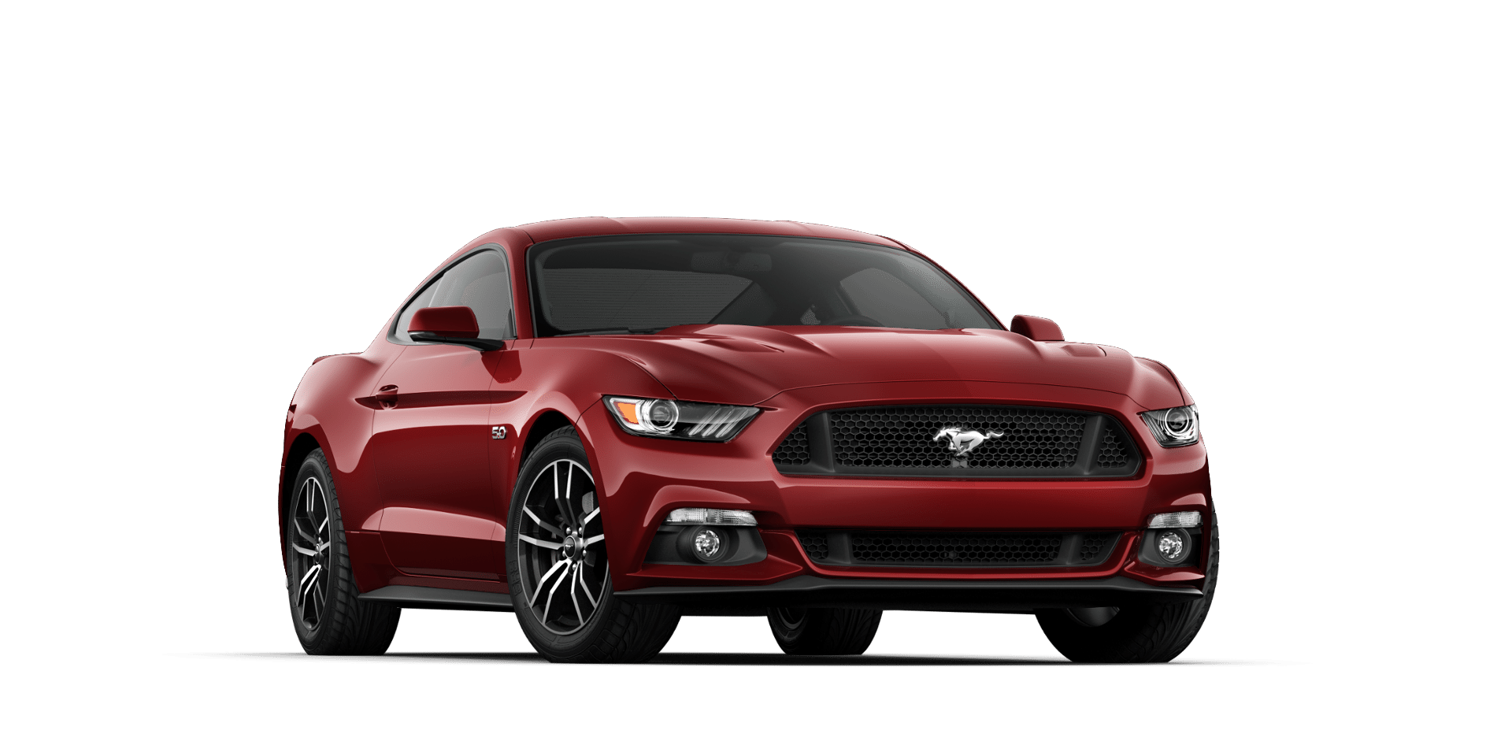
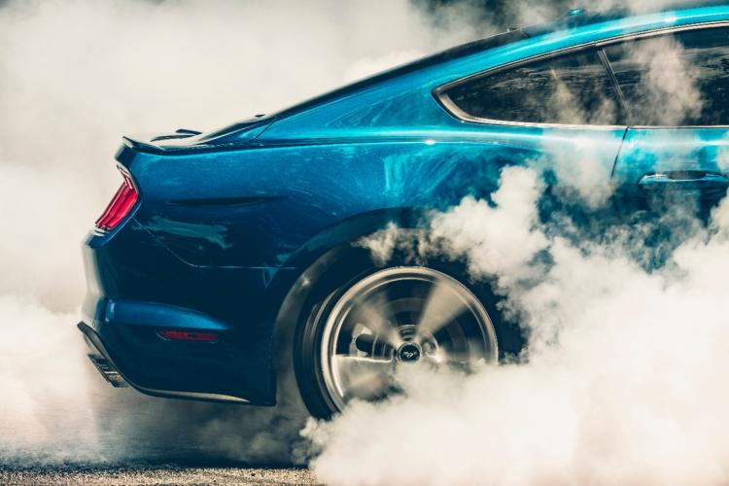
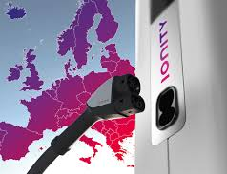
EV STRATEGY PLAYS TO OUR STRENGTHS, BUILDS ON OUR BRANDS, LEVERAGES SCALE AND INNOVATES ACROSS THE VALUE CHAIN
Performance Battery Electric SUV (300 mile range)
by 2020
HEV F-Series
Ionity
Fast Charging
Infrastructure
HEV Mustang
Notes:
We’re focused on building a profitable electric vehicle portfolio by leveraging our high revenue-generating models…not small, cheap compacts where profitability is really challenged.
That means you’re going to see from us, electrifying our iconic nameplates – starting with a hybrid versions of F-150 and Mustang where the hybrid system delivers the same level of performance Mustang customers expect from this iconic vehicle…but we won’t stop there.
We are electrifying “work” by making our leading commercial trucks even better and more useful on the jobsite…
We also plan to continue to expand the police business with our hybrids.
We’re also applying the most emotional design and credible performance attributes from our segment-leading cars, trucks and SUVs to our expanded portfolio of all-electric (BEV) vehicles.
And we’re on track for an exciting performance SUV battery electric vehicle that offers at least a 300-mile range for launch in 2020. [REFER TO MACH I?]
In addition, we’ll be partnering in markets where we can leverage the market-expertise of others to build out our regional product offerings…such as we’re doing with Zotye in China, our first all BEV value brand.
And, we will develop a seamless ownership experience such as developing charging solutions like we’re doing in Europe with Ionity.
To get there, we’re reducing our investment in internal combustion powertrains and reallocating it to electrification.

Slide 6
WE WILL SPEND OVER $11 BILLION ON EVS BY 2022
EV INVESTMENT (BILS)
U.S.
Positioned for EV leadership
HEV offered on all mainstream models
EUROPE
Strong BEV portfolio
Mild hybrids
50%
CHINA
Original Investment
Revised Investment
2015 - 2022
BEVs and hybrids from our CAF and JMC JVs
BEVs from our Zotye JV
2015 - 2020
Notes:
We’re pleased to update you on our increased investment in EVs.
We now expect to spend over $11 billion by 2022 allowing us to substantially increase the number of BEVs we offer around the world and providing an HEV option across all our mainstream models in the U.S.
We understand what drives BEV profitability and our increased investment is enabling us to achieve scale in China, Europe and North America.
We are developing an all new, all electric platform which will be common globally, generating scale for the for battery and other components.

Slide 7
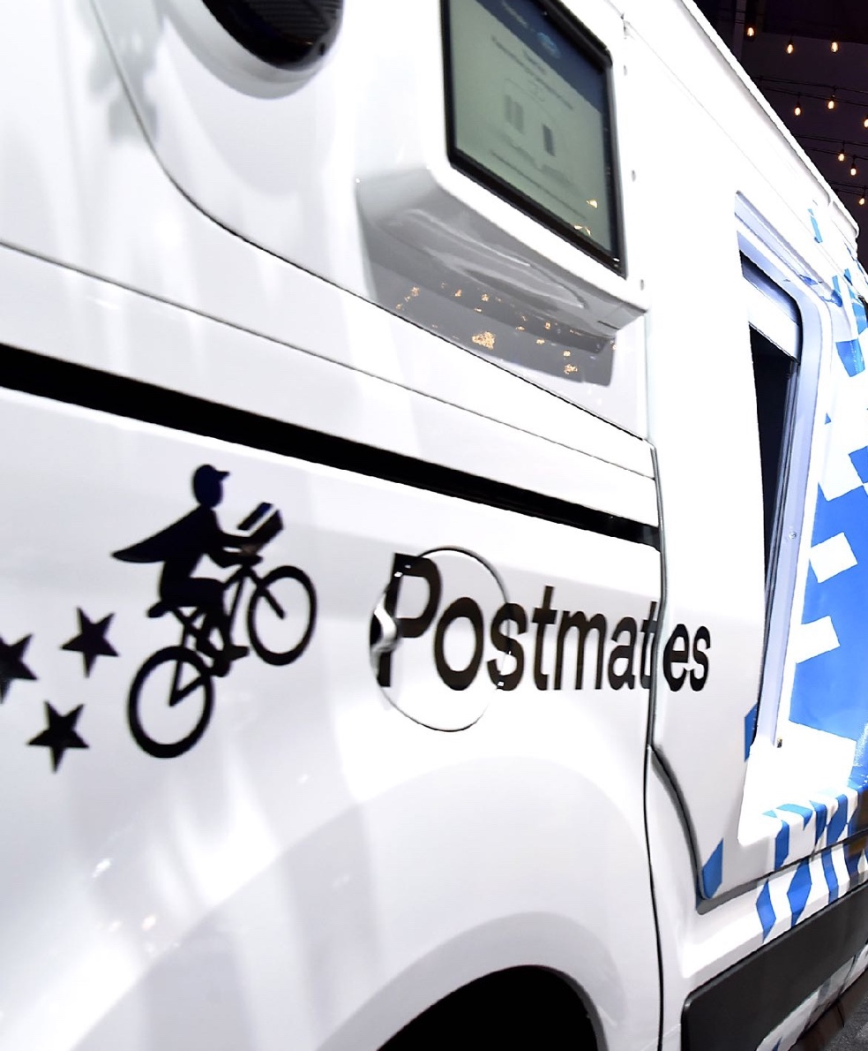
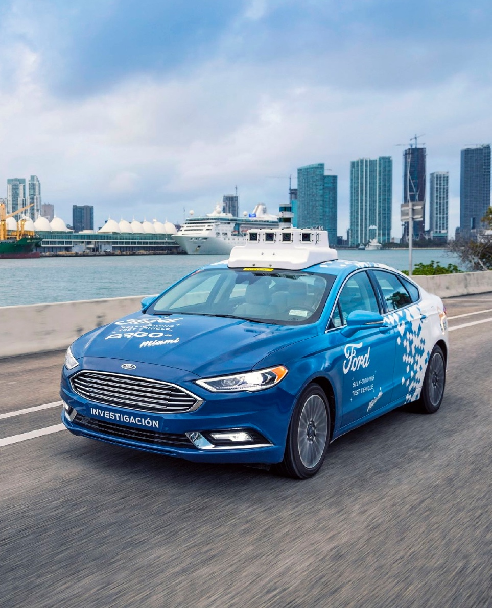
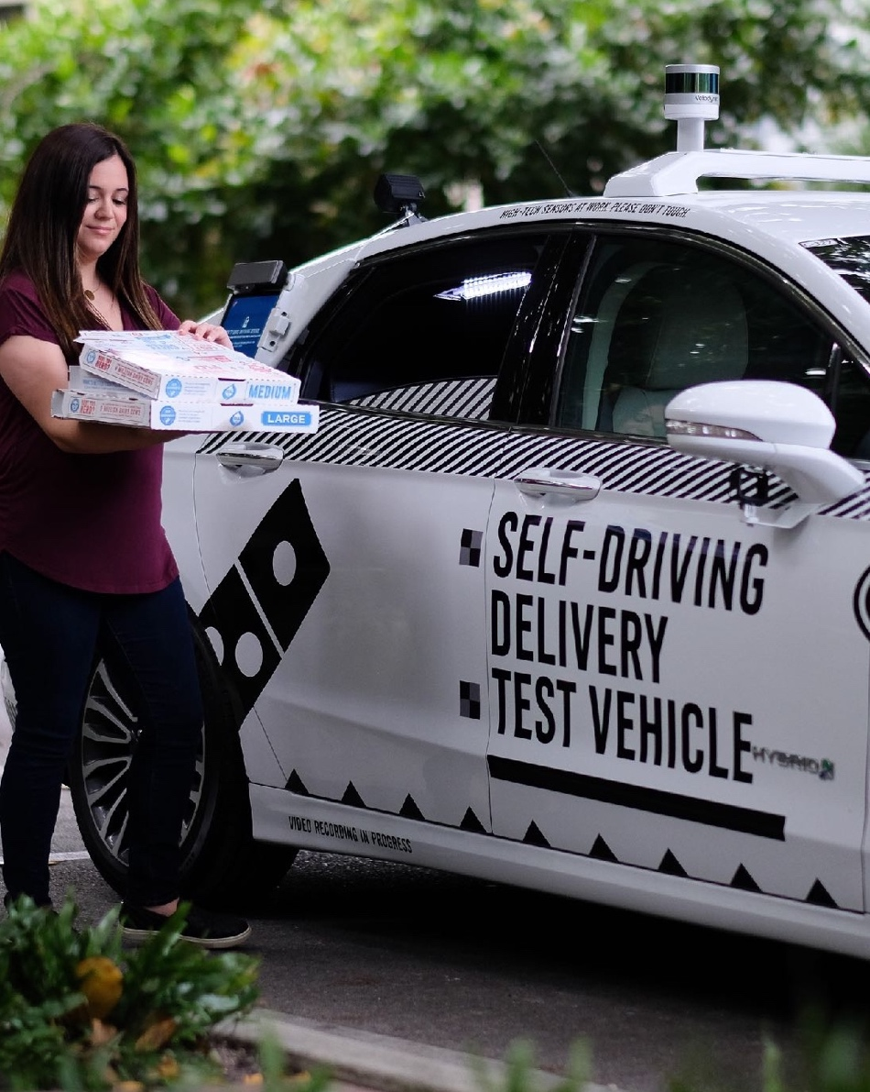
SMART VEHICLES
FOR A SMART WORLD
WORK
Notes:
As we make progress on our commitment to create Smart Vehicles for a Smart World that will help people move more safely, confidently and freely …
There is also a vast potential to help make our customers’ jobs easier, more efficient and more productive.

Slide 8
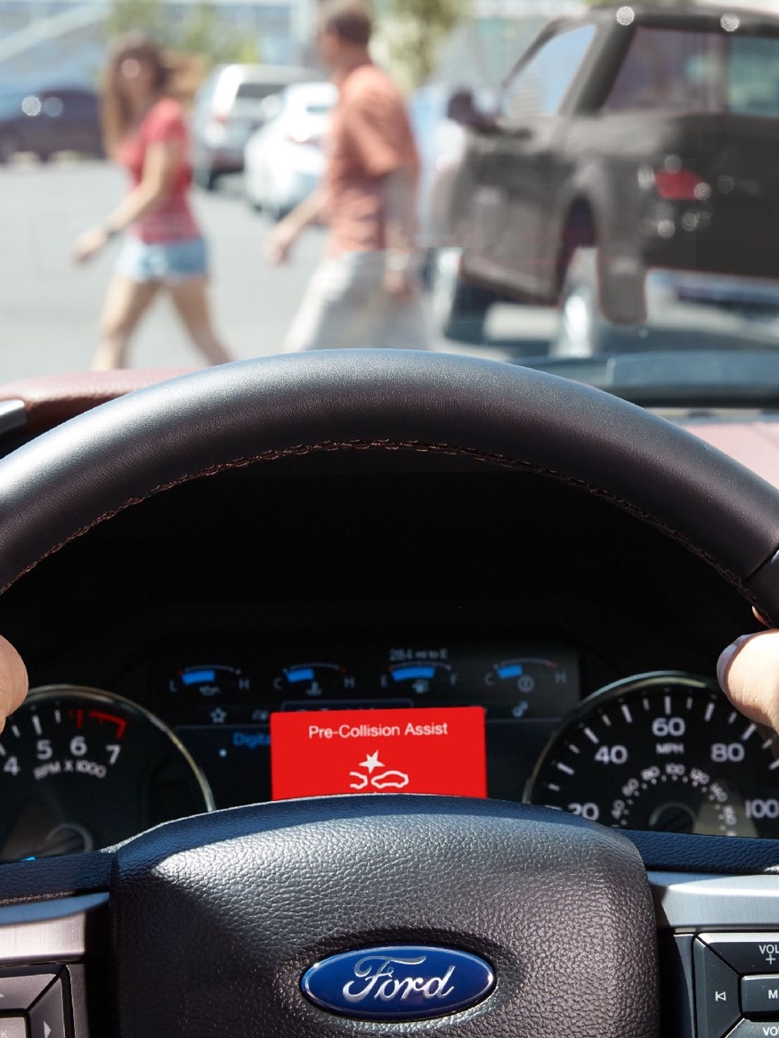
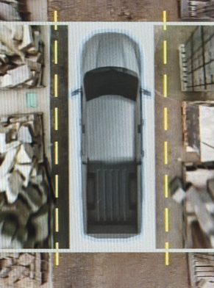
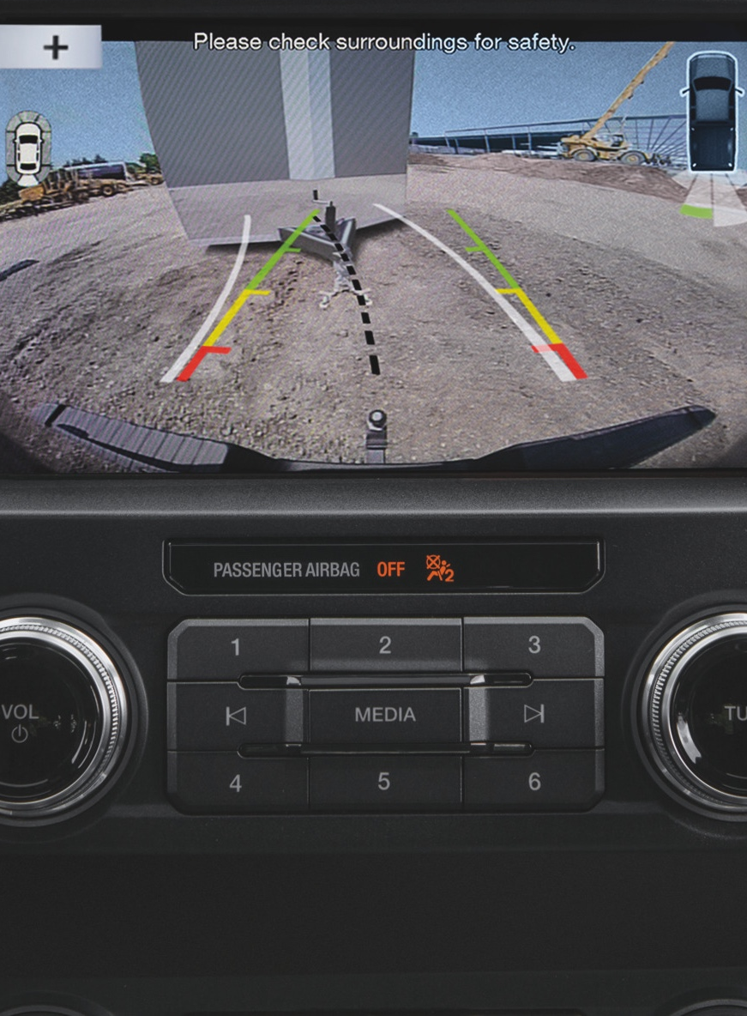
SMART
DRIVER-ASSIST TECHNOLOGIES
Notes:
Imagine the difference smart driver-assist technologies can make for SUVs, trucks, vans and commercial vehicles in this regard.
A single traffic accident can have a serious impact not just on the drivers and passengers, but on the fleet’s bottom line, and for that reason we are offering Automatic Emergency Braking… as well as….
A host of driver-assist features that will save fleets… money… time and… provide peace of mind.

Slide 9

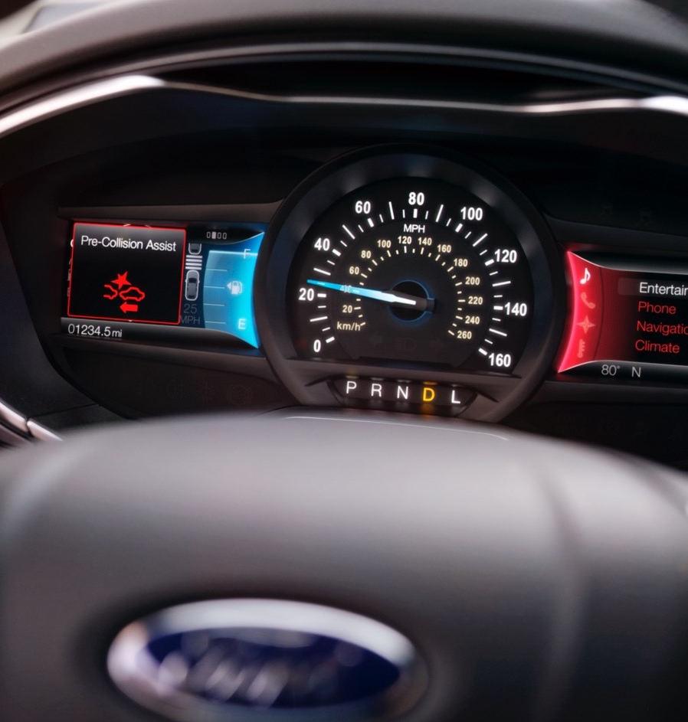
DRIVER-ASSIST TECHNOLOGY
2020MY FUSION
STANDARD CoPilot360
Automatic Emergency Braking with Pre-Collision Assist, Pedestrian Detection and Forward Collision Warning
BLIS® (Blind Spot Information System) with cross-traffic alert
Lane Keeping System includes Lane-Keeping Alert, Lane Keeping Aid and Driver Alert System
Rain-sensing wipers
Reverse Camera

Slide 10
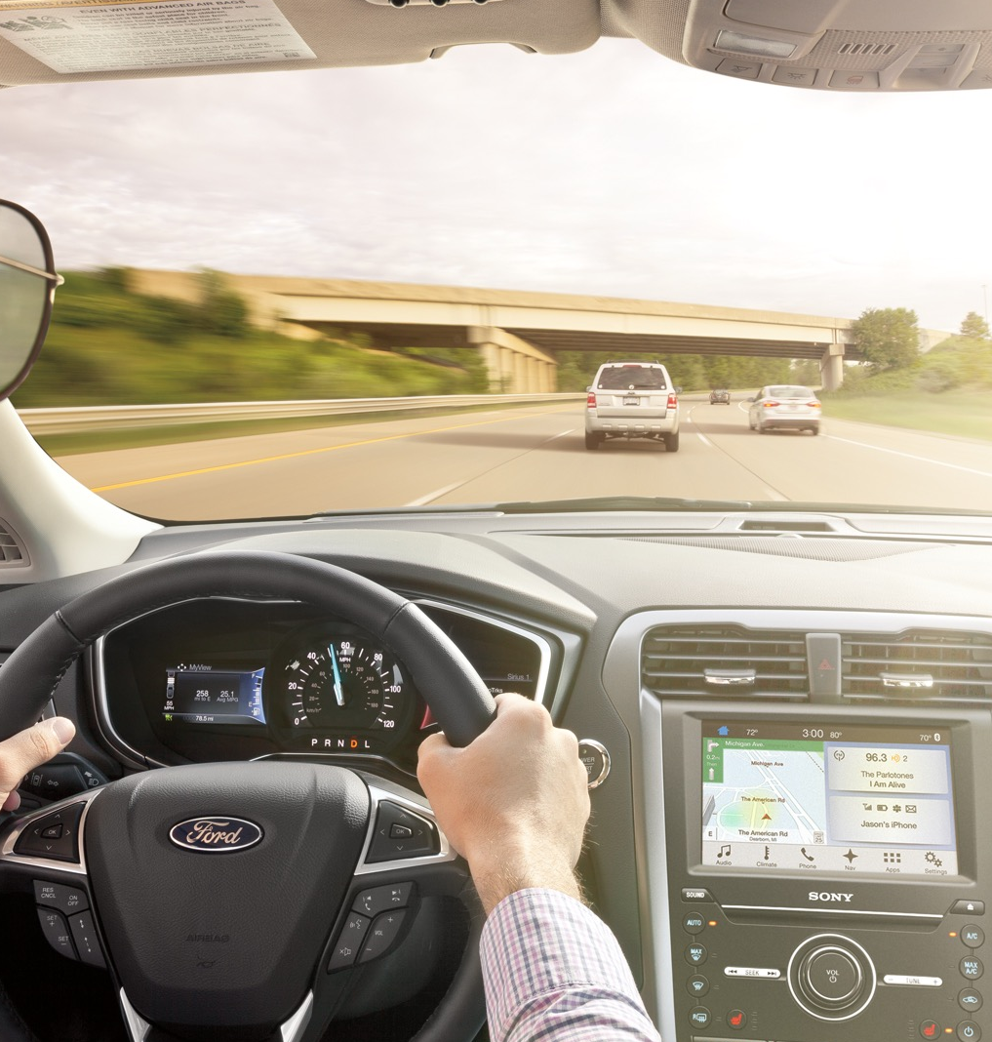
CO-PILOT360 ASSIST
2020MY FUSION
S INCLUDES Available:
4.2” dual, configurable color LCD screen
Adaptive cruise control with stop-and-go
Dual-zone electronic automatic temperature control
Voice-activated SYNC® 3 with Navigation System
SE INCLUDES Available:
SE Appearance Package
SE AWD Package
Power Moonroof

Slide 11
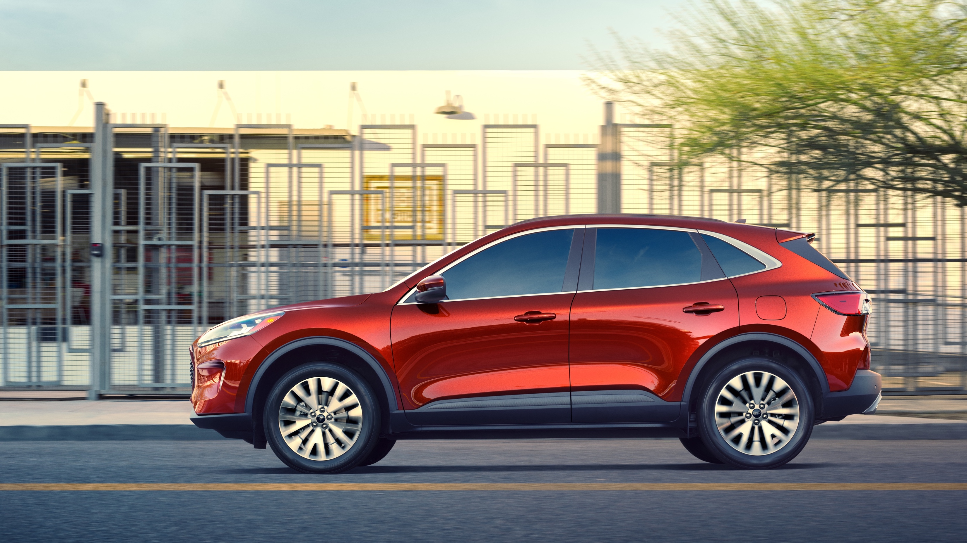

The 2020MY Escape brings style and substance to small SUVs with class-leading hybrids, flexibility and exclusive technology
2020MY
ESCAPE
ORDER BANK OPEN 05/19
Notes:
Balance Out Date – 07/19/19
Job 1 Date – 08/05/19

Slide 12
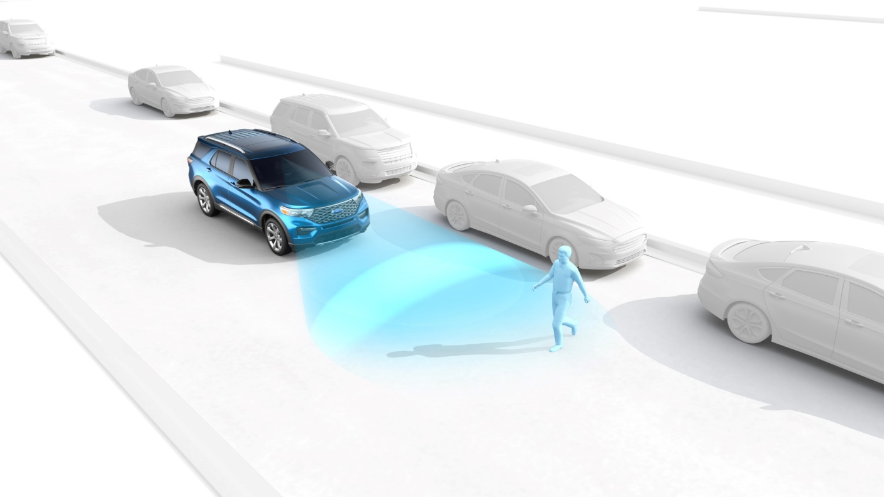
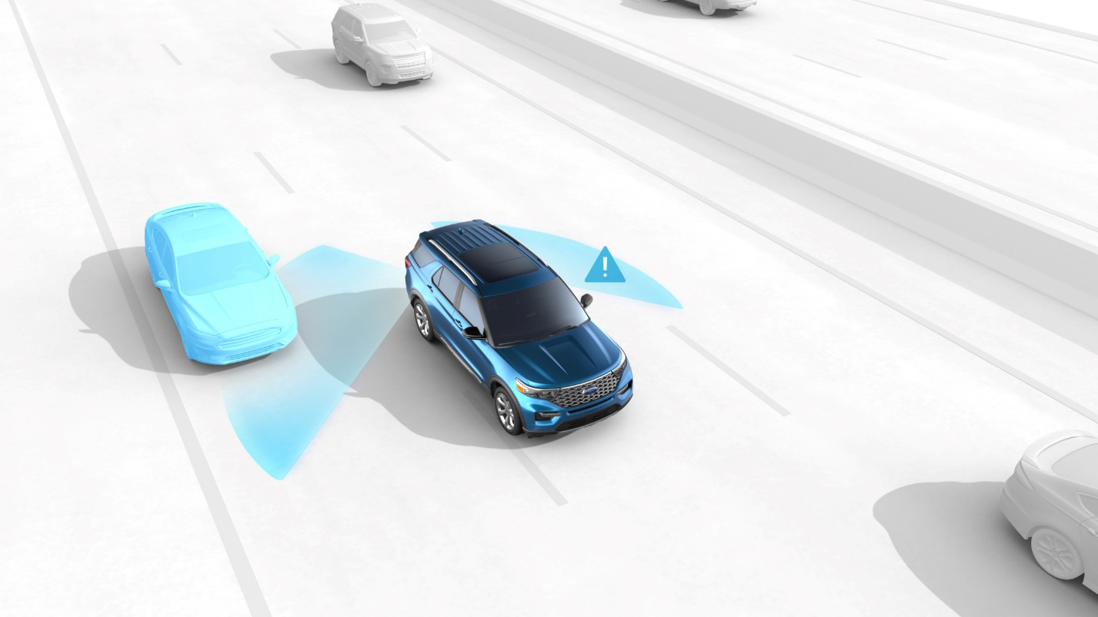
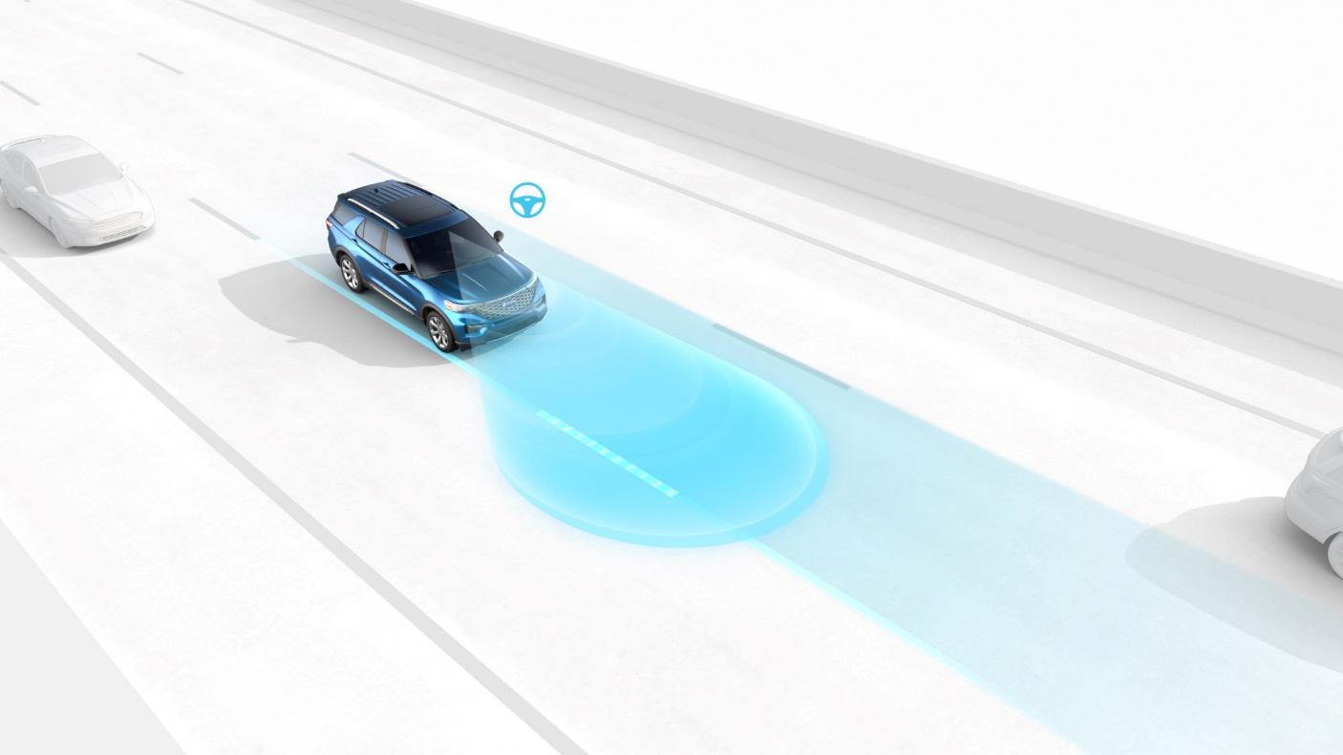
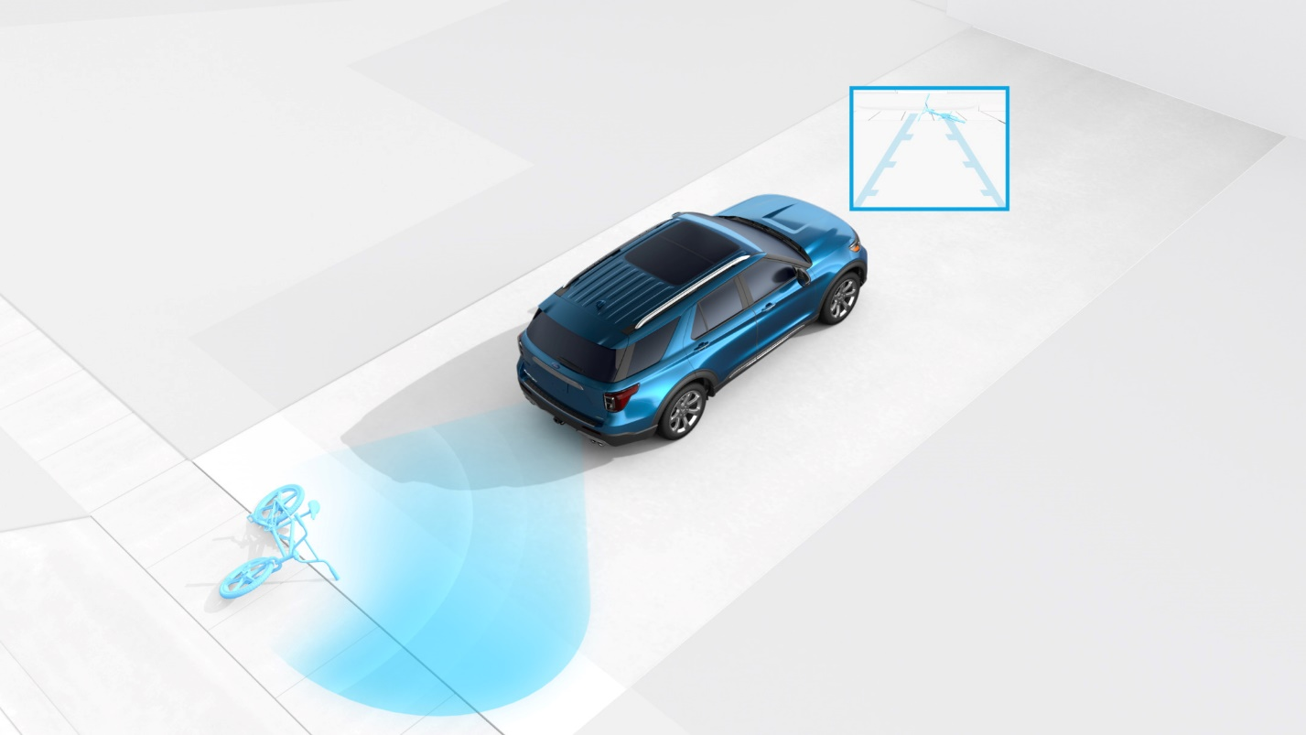
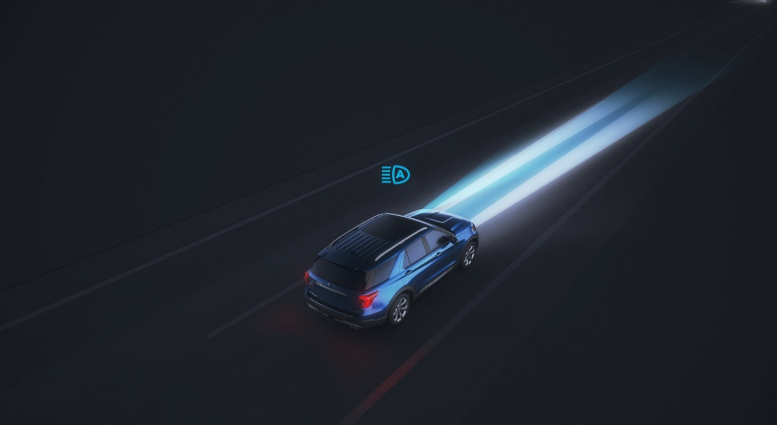
Pre-Collision Assist with Automatic Emergency Braking includes Pedestrian Detection, Forward Collision Warning with Dynamic Brake Support
BLIS® (Blind Sport Information System) with Cross-Traffic Alert
Lane-Keeping Assist (includes Lane-Keeping Alert and Driver Alert)
ALL-NEW 2020MY ESCAPE STANDARD CO-PILOT 360™ FEATURES
Reverse Sensing System
Auto Headlamps with Auto High Beams
Notes:
The 2020MY Escape is the smartest-ever small SUV… it features Ford Co-Pilot360 offering standard technologies that will keep drivers safer than ever before.

Slide 13
ELECTRIFIED VEHICLES

