Slide 1




Electrification Funding:
Sparking Growth Across the Nation
June 6, 2024

Slide 2



Today’s Agenda
Review current funding opportunities towards electrification
Tips on applying for funding
Review available recourses for your assistance throughout these processes.

Slide 3




Welcome to our Speakers
Anthony Maietta
Life Scientist
Region 5 U.S. EPA’s Air and Radiation Division
Jessica Stoll
Program Manager
Grace Andrews
Project Coordinator
Columbia-Willamette and Western Washington Clean Cities Coalition
Andrew Byrne
Director of EV Products and Marketing

Slide 4
Anthony Maietta
Region 5
U.S. Envioronmental Protection Agency’s
Air and Radiation Division

Slide 5
Participant Poll
*Participate by entering in the chat*
  Are you or your company interested in the 2024 EPA Clean Heavy-Duty Vehicles Grant? Y/N

Slide 6
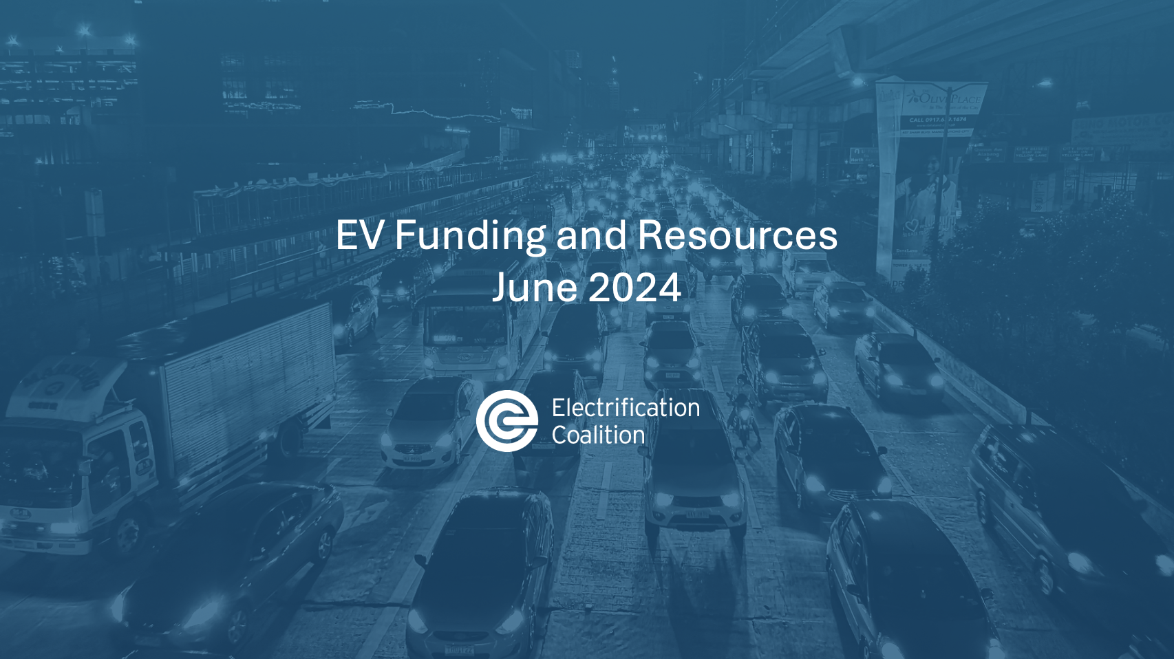

EV Funding and Resources
June 2024

Slide 7
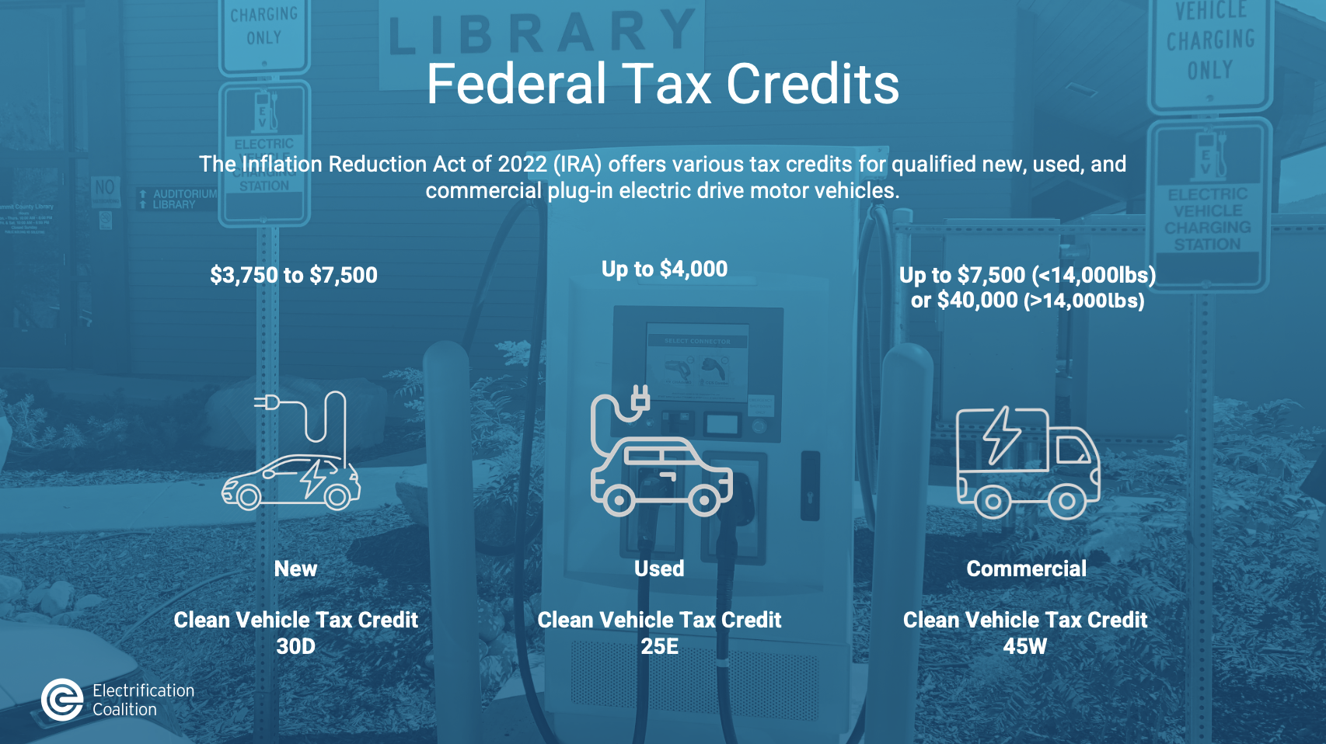
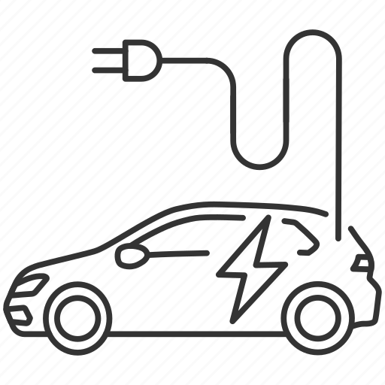


Federal Tax Credits
The Inflation Reduction Act of 2022 (IRA) offers various tax credits for qualified new, used, and commercial plug-in electric drive motor vehicles.
$3,750 to $7,500
Up to $4,000
Up to $7,500 (<14,000lbs) or $40,000 (>14,000lbs)
New
Used
Commercial
Clean Vehicle Tax Credit 30D
Clean Vehicle Tax Credit 25E
Clean Vehicle Tax Credit 45W

Slide 8


Commercial Clean Vehicle Tax Credit (45W)
Vehicle must be used for business purposes
Can be used by Tax Exempt Entities (municipal fleets, non-profits, schools).
No final assembly, sourcing, FEOC requirements.
No MSRP caps or income limits.
Leases are eligible for this tax credit.
Credit Caps (whichever is less)
Max credit: $7,500 (under 14,000 pounds)
$40,000 (over 14,000 pounds)
up to $7,500
or $40,000
30% of sales price (EV) | 15% of sales price (PHEV) | Incremental cost of vehicle
Notes:
Fleet analysis is the process of generating the best recommendation of fleet vehicles, possible charging locations, and number of vehicles needed for a given fleet. This analysis is derived from determining the goals of the organization utilizing this fleet, obtaining data on the current roster of fleets and usage of these vehicles, gathering data on the vehicle types, vehicle makes, vehicle models, vehicle model years, vehicle annual fuel use, annual miles, maximum daily range, and primary usage.
After gathering this data, analysis will identify specific opportunities for deployment and use of EVs in the fleet based on the organizational goals and priorities (e.g. options that provide the highest overall life-cycle cost savings and/or shortest ROI). This analysis focuses on identifying the best applications determined by data on vehicle size, class, duty-cycle, usage, fueling logistics, and expected replacement date.

Slide 9
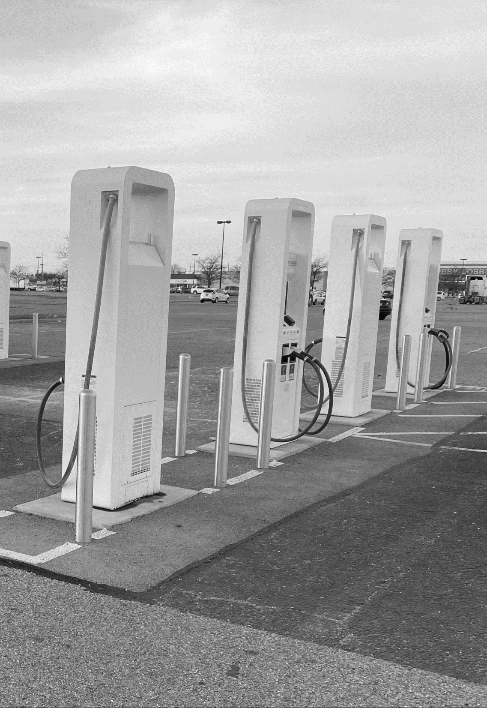

Used EV Tax Credit (25E)
Personal requirements:
Buyer must meet income limits:
  $150,000 for joint filers
  $112,500 for heads of households
  $75,000 for all other filers
Vehicle requirements:
Used EV must be at least 2 years old.
Vehicle price cannot exceed $25,000.
The vehicle must not have been previously purchased with a used EV tax credit.
No final assembly, sourcing, or FEOC requirements
$4,000
(or 30% of
vehicle price)
Notes:
Slide 7: FUNDING ALLOCATION TIMELINE
There are $2.5 billion up for grabs in this program over the next 5 years, so there will likely be at least a couple of rounds of funding
On the screen, you can see the award sizes; they are quite large, hopefully accommodating for the varying costs associated with installing chargers
Current cycle deadline is May 30 – so if you haven’t started your application, it might be tight to get it in, but not to worry, as another cycle is expected to open early next year
Some entities are already forging partnerships and relationships to prepare for the next funding cycle, so it’s not too early to start planning for next year!

Slide 10
New Clean Vehicle Tax Credit (30D)
Personal requirements:
Buyer must meet income limits:
  $300,000 for joint filers
  $225,000 for heads of households
  $150,000 for all other filers
Vehicle requirements:
Final assembly must be in North America
MSRP Requirement
  $80,000 for vans, SUVs, and pickup trucks
  $55,000 for other vehicles
Meet Foreign Entity of Concern Rule (new)
$3,750
to
$7,500

Slide 11
New Clean Vehicle Tax Credit (30D)
Critical minerals sourcing requirement ($3,750):
The percentage of the value in critical minerals must be extracted or processed in the US or a country with a US free trade agreement, increasing each year
Battery components sourcing requirement ($3,750):
The percentage of the value of battery components must be manufactured or assembled in North America, increasing each year
Year | 2023 | 2024 | 2025 | 2026 | 2027
Percentage | 40% | 50% | 60% | 70% | 80%
Year | 2023 | 2024-2025 | 2026 | 2027 | 2028 | 2029
Percentage | 50% | 60% | 70% | 80% | 90% | 100%

Slide 12
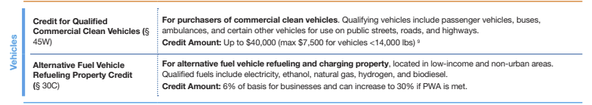
Elective Pay (AKA Direct Pay)
Proposed guidelines from the IRS released in June
Elective pay credit allows tax-exempt and governmental agencies to benefit from tax credits from which they were previously ineligible based on their lack of federal tax burdens; the credit comes as a refund
Applies to 12 of the Inflation Reduction Act’s tax credits
Notes:
Slide 7: ELECTIVE PAY
Historically, investments in clean energy have been offset by tax credits available to private entities and individuals.
Tax-exempt entities, like local and state governments, could not take advantage of federal tax credits since they typically don’t have a tax burden.
However, under the Inflation Reduction Act (IRA), tax-exempt entities can now receive clean energy-related tax credits through elective pay, also called direct pay.
make it more cost-effective for government entities to participate in the transition to clean energy and electric vehicles.
proposed guidelines on how this process will work, and the final guidelines will come out later this year.

Slide 13
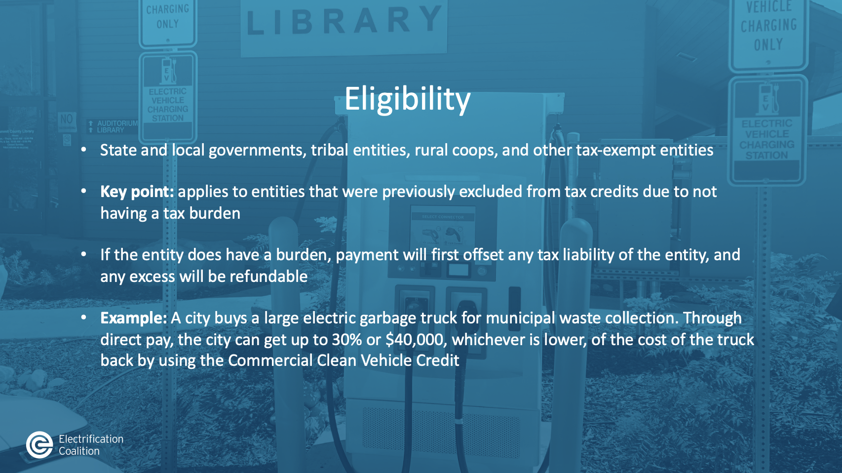
Eligibility
State and local governments, tribal entities, rural coops, and other tax-exempt entities
Key point: applies to entities that were previously excluded from tax credits due to not having a tax burden
If the entity does have a burden, payment will first offset any tax liability of the entity, and any excess will be refundable
Example: A city buys a large electric garbage truck for municipal waste collection. Through direct pay, the city can get up to 30% or $40,000, whichever is lower, of the cost of the truck back by using the Commercial Clean Vehicle Credit
Notes:
Slide 8: ELIGIBILITY
Under elective pay, state and local governments, tribal entities, rural co-ops, and other tax-exempt entities like nonprofits can receive credits.
Example: A city buys a large electric garbage truck for municipal waste collection. Through direct pay, the city can get up to 30% or $40,000, whichever is lower, of the cost of the truck back by using the Commercial Clean Vehicle Credit

Slide 14

Elective Pay Process
Identify the credit
  Commercial Clean Vehicle Credit (45W)
  Alternative Fuel Vehicle Refueling / Recharging Property Credit (30C)
Complete your project and put it in service
Determine the tax year; this will set your filing deadline
Complete pre-filing with the IRS
File the tax return
Receive your refund after your return is accepted
Notes:
Slide 11: PROCESS
Identify your project and the credit it is eligible for.
Complete your project and put it in the service.
Determine the tax year to set your filing deadline.
Complete a pre-filing form with the IRS. This form will come out later this year.
File the tax return and receive your refund after it is accepted.

Slide 15

EV Rebates are Stackable
  Federal:
  IRS Federal Tax Credit: $7,500
  State Incentives:
  Vermont EPA EV Rebate: $4,000
  Utility Incentives:
  Burlington Electric EV Rebate: $2,300
  Total potential savings: $13,800!
  Ford F-150 Lightning
  MSRP: $54,955
Notes:
Electric mobility is one of the best scalable alternatives for reducing U.S. oil dependence. Electricity is low and stable in price and domestic in source--it is ubiquitous, the electricity grid is growing progressively cleaner, and prices are insulated from unstable oil markets.

Slide 16
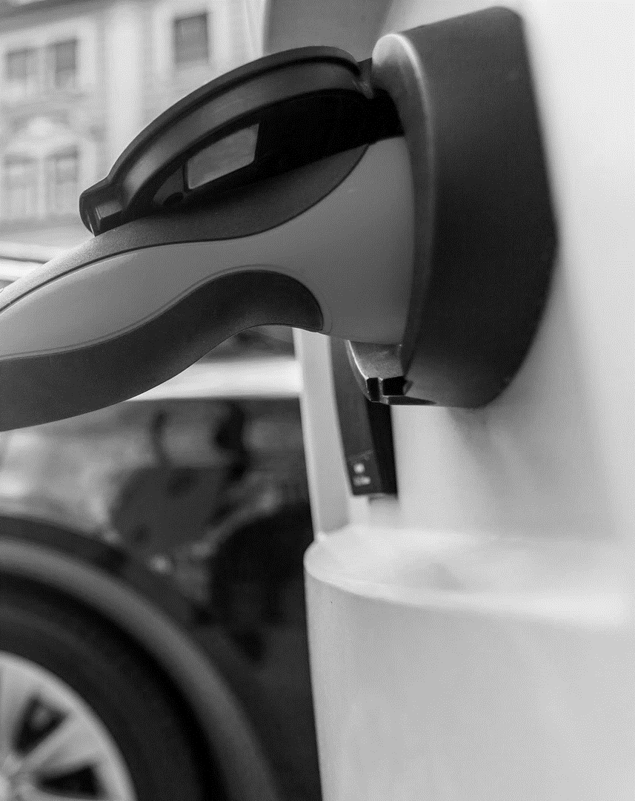

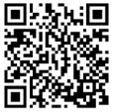
The EV Funding Finder
Capitalizes on unprecedented investment in transportation electrification
User-friendly tool to identify federal transportation electrification funding opportunities
Answers the question, “Where is the money, and how do I get it?"
Supports efficient, effective, and equitable deployment of funds
electrificationcoalition.org/ev-funding-finder/
Notes:
Slide 2: EV FUNDING FINDER
Following the passage of new legislation like the BIL
User-friendly tool developed by the EC that allows you to identify multiple funding pathways for transportation electrification projects.
Answers the question of where is the federal money and how do I get it? Follows the passage of legislation that commits unprecedented funding to electrification.
Valuable to entities trying to navigate the sometimes-complicated process of identifying funding pathways.

Slide 17
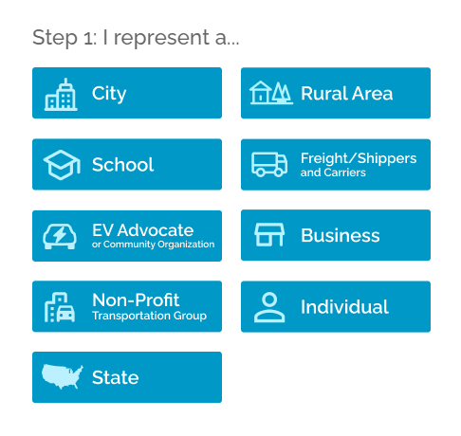
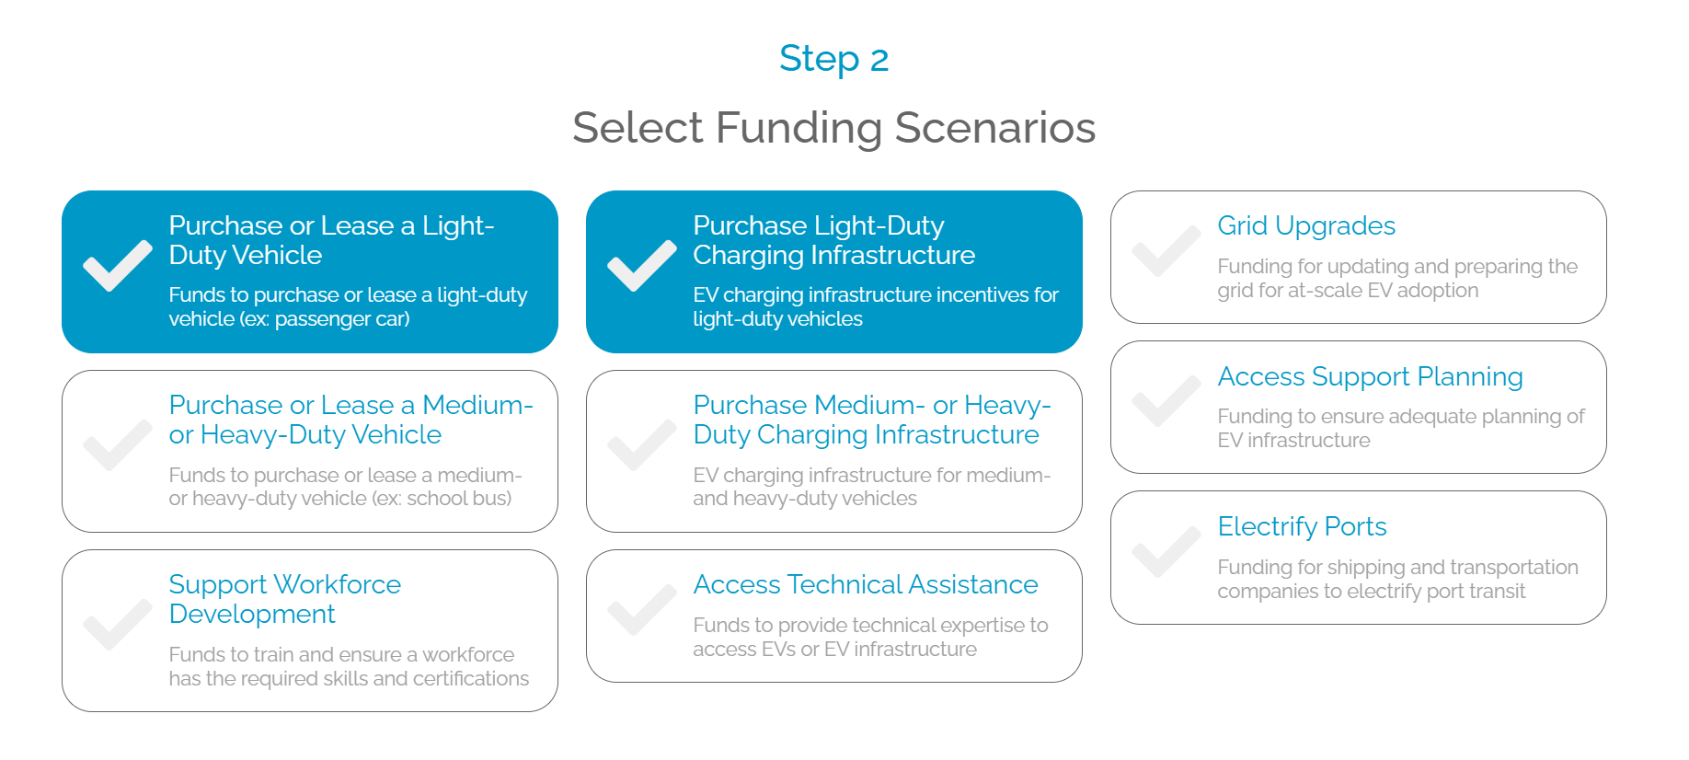
Using the Tool
Notes:
Slide 3: USING THE TOOL
Demonstrate:
Step 1: Who?
Step 2: What?
Step 3: There is an optional box to provide you with information. By providing your information, you can opt to receive important updates and information about the tool.

Slide 18
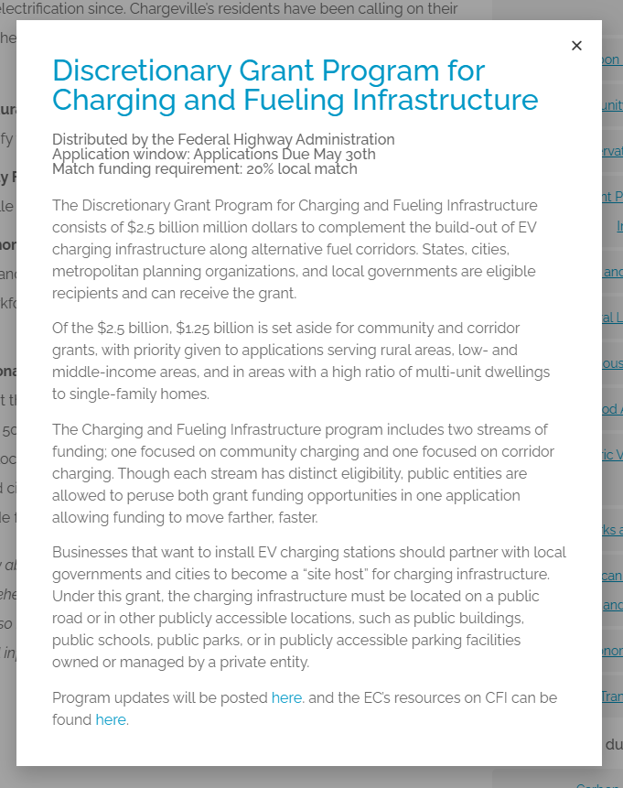
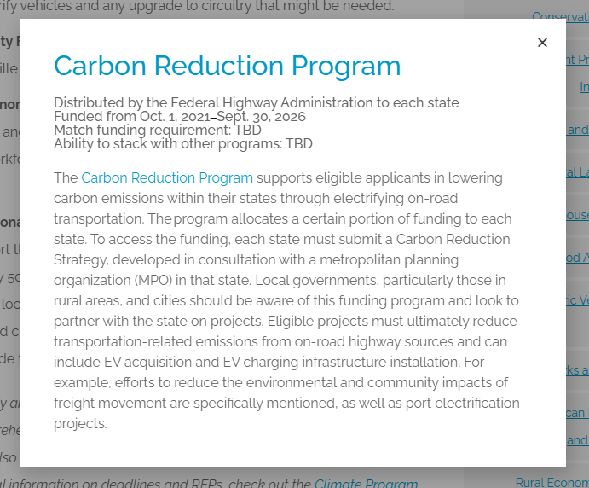
Results
Notes:
Slide 4: RESULTS
Explore funding pathways
you will see all the eligible funding scenarios. When you click on the funding scenarios, a popup will appear with the funding stream’s matching requirements, stack ability options, and other pertinent information.
Other notes about the tool:
Where can you find it?
Does the tool get updated?
Do you have questions?

Slide 19

Participant Question
*Participate by entering in the chat*
  Are you the decision maker or have the capabilities to encourage your employer for workplace charging? Y/N
Drive Clean Indiana: EMPOWER 7
Wisconsin Clean Cities: EMPOWER 29

Slide 20



Grace Andrews, Project Coordinator
Columbia-Willamette Clean Cities
^{June 6, 2024}

Slide 21

Today’s Roadmap
Why Workplace Charging?
EMPOWER Project
  What is EMPOWER?
  Why join
  Next steps
Q&A

Slide 22

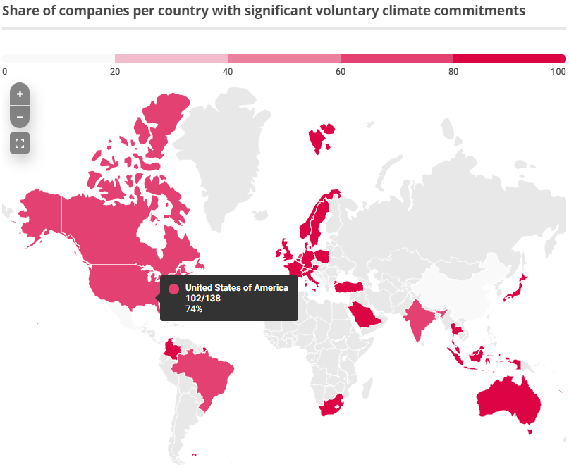
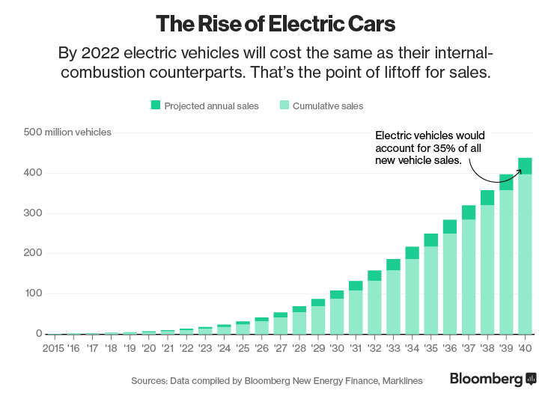
Why Workplace Charging?
EV Market Demand
Corporate Sustainability Goals
Value to the Workplace
Source: Climate Impact Partners:
Notes:
EV Adoption is on the rise and expected to increase – Bloomberg estimates global adoption will cross 400 million EVs by 2040, and all those EV owners will need a place to charge. We know that at-home charging isn’t going to cut it alone
Corporations globally are increasingly committing to carbon reduction and sustainability goals. Climate Impact Partners estimates that two-thirds of Fortune Global 500 companies have a significant carbon commitment, meaning they need to reduce emissions. And they’re looking at the most cost-effective and easy way possible to do so.
And finally, the lesser-known value to the workplace, that includes:
Demonstrates climate leadership
Attracting and retain top talent
Improving employee satisfaction
Earning certification points for local and national sustainability programs (e.g., LEED)
Coaxing employees back to the office
All from installing workplace charging.

Slide 23
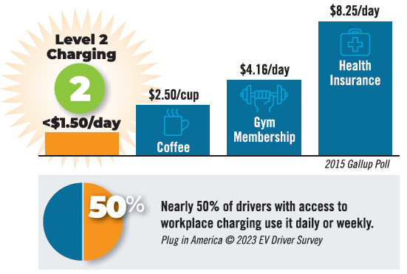
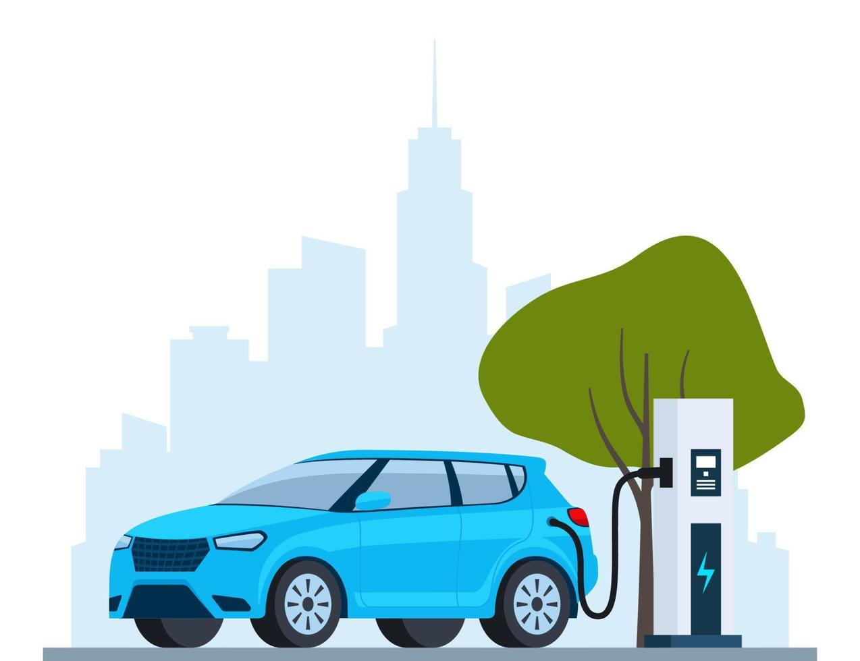
Why Workplace Charging? Value.
Boost your brand
Demonstrate climate leadership
Attract and retain top talent
Improve employee satisfaction
Earn certification points for local and national programs (e.g., LEED)
Offer employees coming back to the office a convenient and reliable place to charge their vehicle
Notes:
EV Adoption is on the rise and expected to increase – Bloomberg estimates global adoption will cross 400 million EVs by 2040, and all those EV owners will need a place to charge. We know that at-home charging isn’t going to cut it alone
Corporations globally are increasingly committing to carbon reduction and sustainability goals. Climate Impact Partners estimates that two-thirds of Fortune Global 500 companies have a significant carbon commitment, meaning they need to reduce emissions. And they’re looking at the most cost-effective and easy way possible to do so.
And finally, the lesser-known value to the workplace, that includes:
Demonstrates climate leadership
Attracting and retain top talent
Improving employee satisfaction
Earning certification points for local and national sustainability programs (e.g., LEED)
Coaxing employees back to the office
All from installing workplace charging.

Slide 24
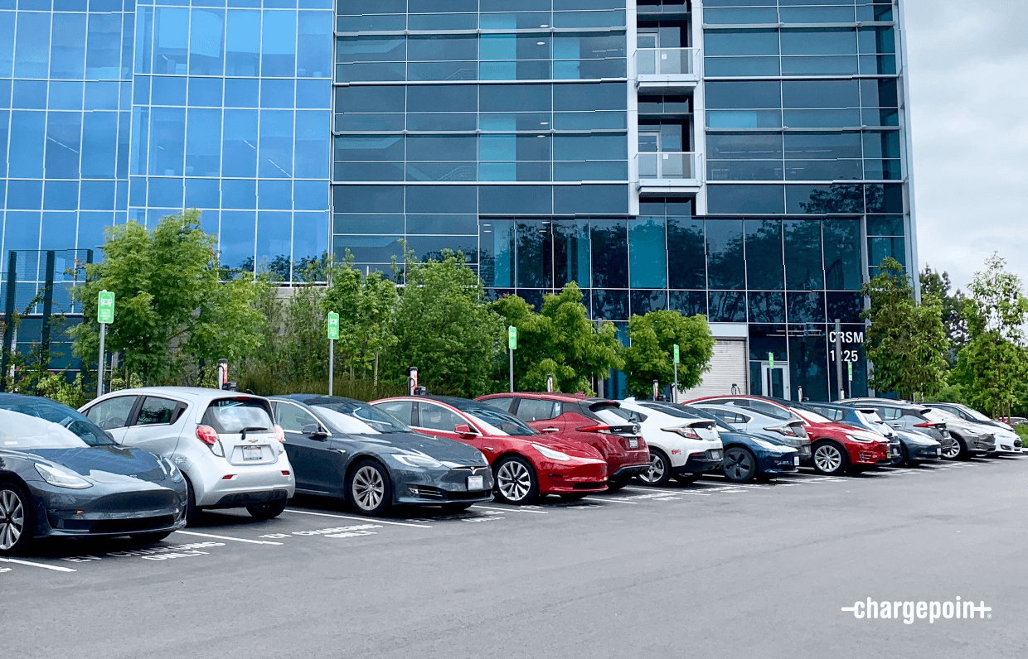
What’s the Holdup?
What days and times will be most popular for charging?
How many charging stations are needed to meet anticipated demand?
Should employees pay a fee for workplace charging? How much?
Should charging stations be accessible to the public?
What will this cost?
How long will a project take?
What equipment should I consider purchasing?
?
Too many questions -
and no clear paths to find answers!
That’s where EMPOWER comes in.
Notes:
And a low awareness from workplaces of the non-monetary value proposition I just walked through.

Slide 25

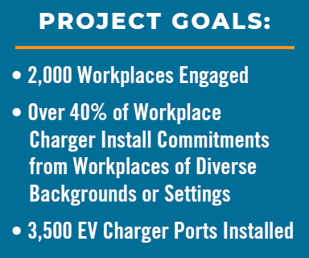









The EMPOWER Workplace Charging Project
US Department of Energy-funded, nationwide project
30+ regional Clean Cities Coalition partners participating nationwide
Helping workplaces realize benefits and tackle barriers to installing workplace charging!
www.workplacecharging.com
Notes:
So what are we doing to help solve the problem?

Slide 26
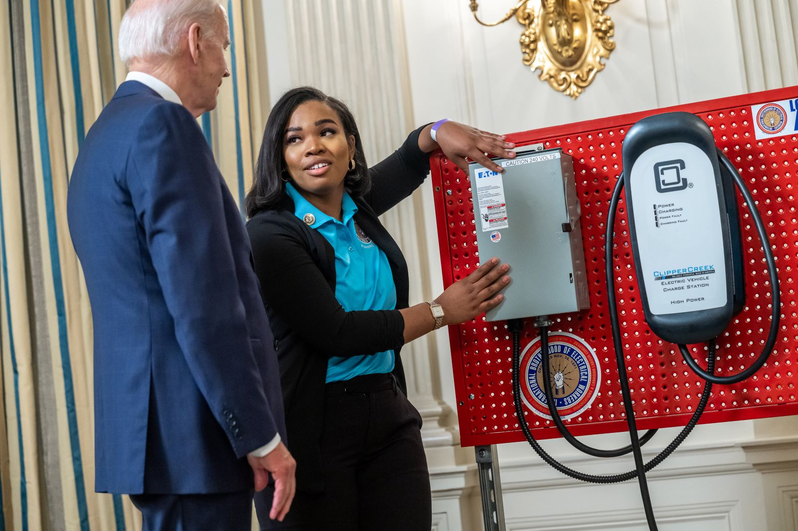
Energy and Environmental Justice
EMPOWER is the first and only equity-focused, nationwide charging project
Our EEJ Action plan aligns with the White House’s Justice40 Initiative
Our goal: Direct at least 40% of all project benefits to workplaces located in, or employing members of, historically disinvested or pollution-overburdened communities.
Notes:
Photo source: https://www.evergreenaction.com/blog/how-we-can-advance-environmental-justice-by-tackling-transportation-sector-pollution

Slide 27
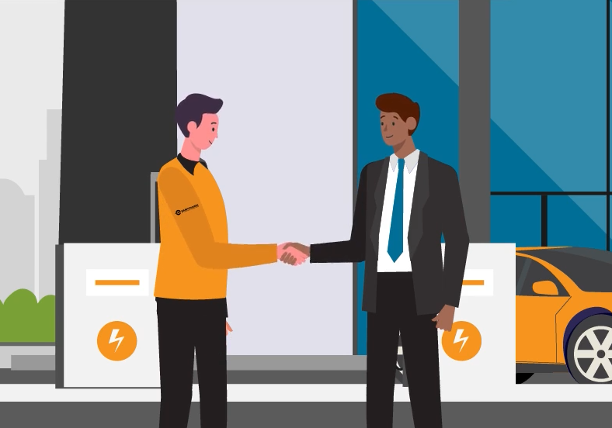
Why Join EMPOWER? Resources.
Access to personalized workplace charging coaching from our Clean Cities Coaches
Learn about incentives both local and nationwide to help fund your project
Your local Clean Cities Coalition Coach will be there with you every step of the way.
Access to project resources and tools:
  Workplace charging pocket guide
  Equipment selection guides
  How to handle metering and payment
Notes:
EMPOWER is helping by providing…

Slide 28
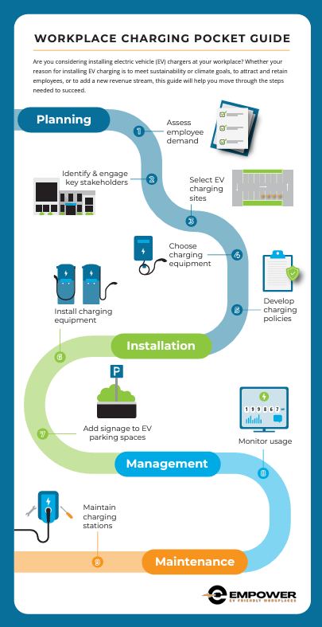
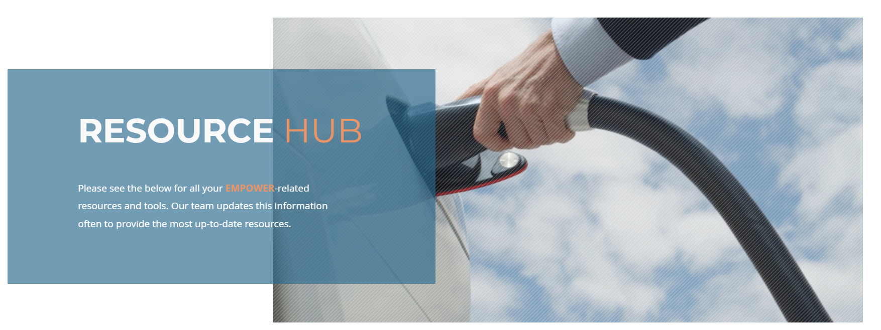
Gain access to useful resources
Visit our Resource Hub to learn more about our detailed, approachable resources that will help you become a workplace charging expert!
Notes:
As an EMPOWER workplace, you'll gain access to powerful resources to help you on your path to WPC, including
Our WPC pocket guide
A sample employee survey on WPC
Resources to help you understand your options for equipment, payment, and more

Slide 29
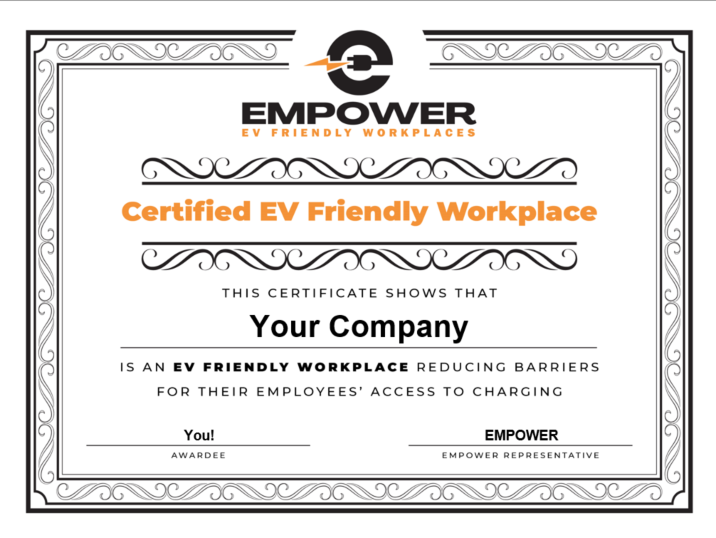
Why Join EMPOWER? Recognition.
Recognition locally and nationally for workplace EV success stories
  Your logo featured on our website
  A certificate to display in your office
  Get your story featured on social media or other media outlets

Slide 30

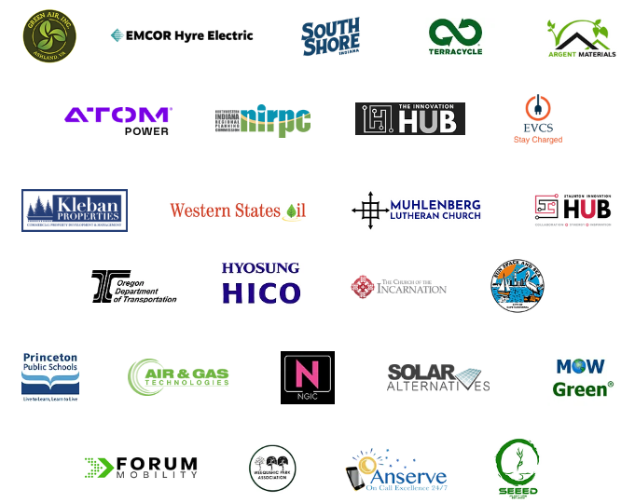

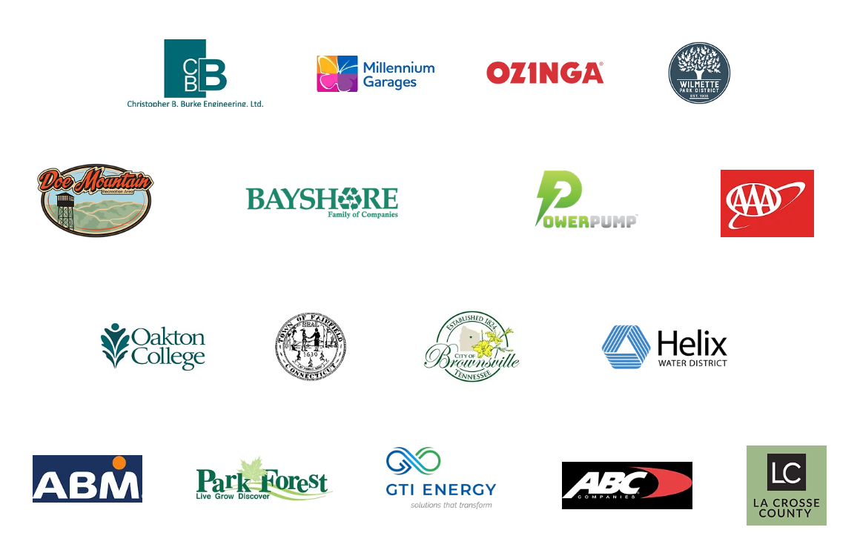
Join our growing list of Pledged Employers
300+ employers pledged 70+ successful installations so far

Slide 31
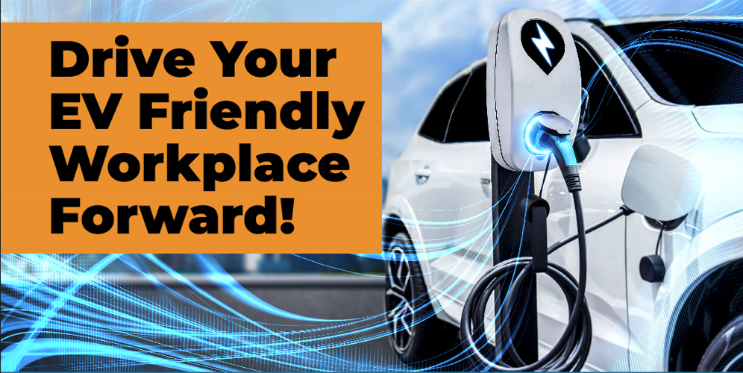
Next Steps
Sign our EMPOWER Pledge on workplacecharging.com
A Clean Cities Coalition coach will reach out to you
Receive personalized coaching and resources
Receive recognition for your WPC accomplishments!

Slide 32
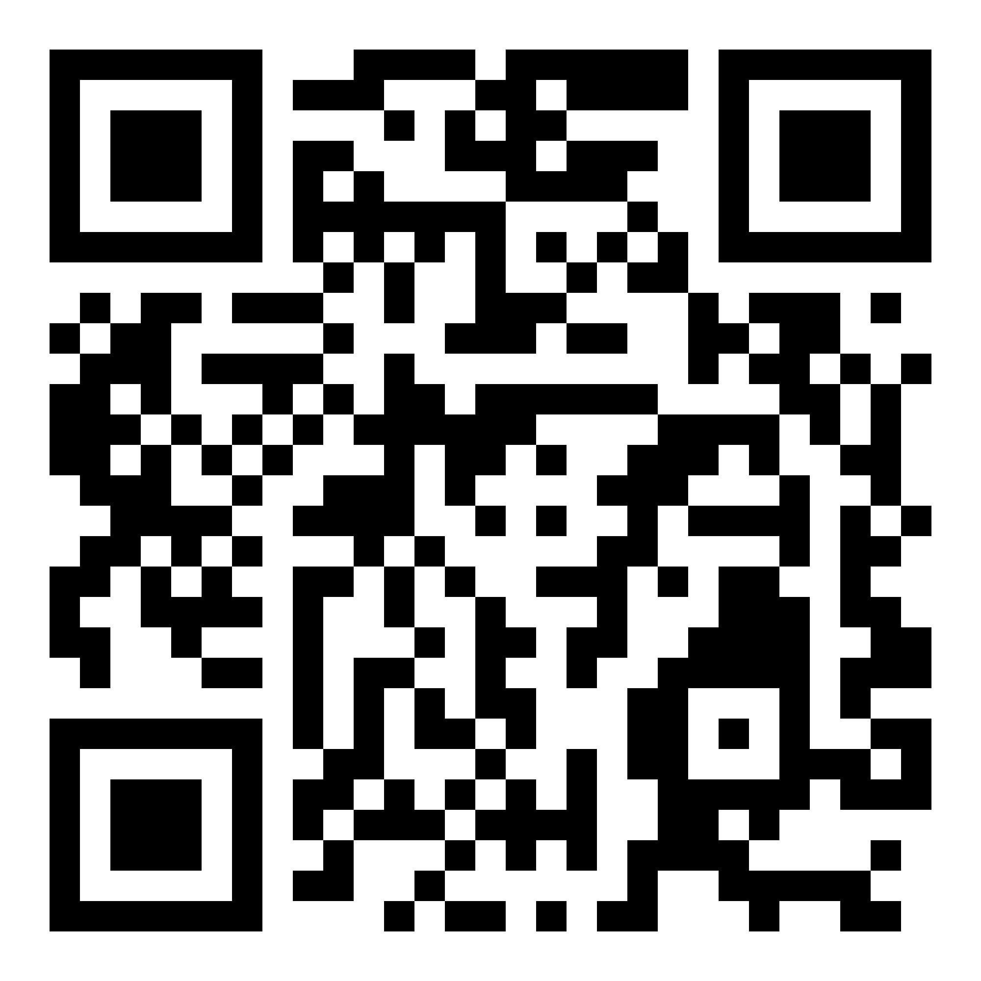

Join us for our next webinar!
SIGN UP TODAY!
Webinar: Successful Workplace Charging Initiatives
Thursday, June 20th at 11am PT

Slide 33

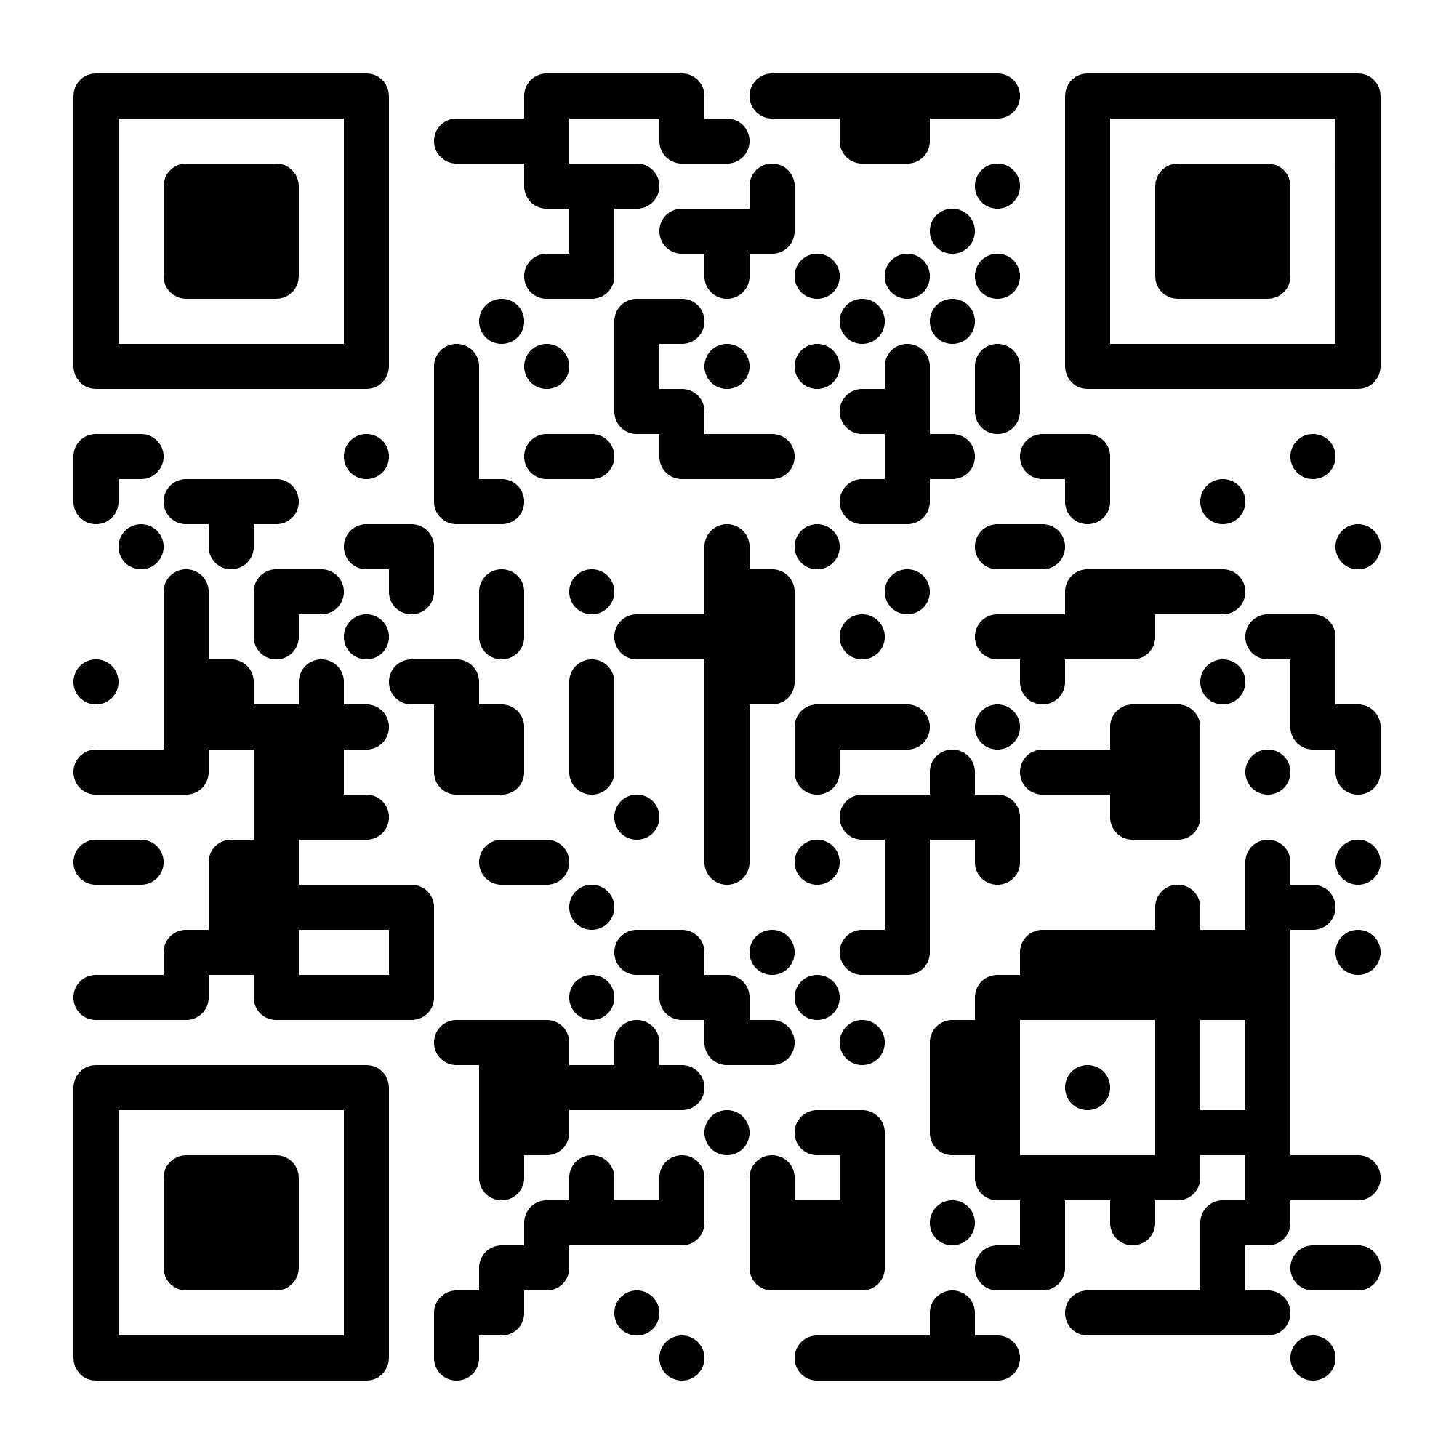
Questions?
Grace Andrews, grace@nwcleancities.org
www.workplacecharging.com

Slide 34
Andrew Byrne
Director of EV Products

Slide 35
Participant Question
*Participate by entering in the chat*
  Are you interested in signing the pledge for Workplace EV Charging? Y/N
Drive Clean Indiana: EMPOWER 7
Wisconsin Clean Cities: EMPOWER 29

Slide 36
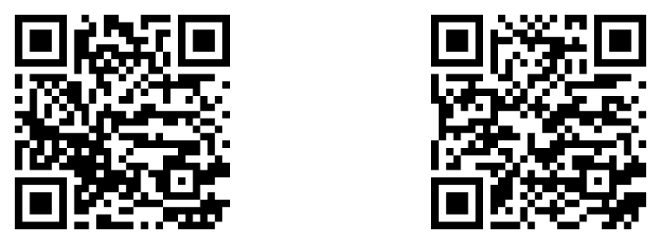
Wisconsin Clean Cities & Drive Clean Indiana
Coalition goals
  Advancement of alternative fuels, vehicles & technology
  Reduce the nation’s dependance on imported oil
  Support local jobs
  Drive economic development
  Improve air quality
  Improve the quality of life
Become a member today!

